Slide 1
Introduction to Information Visualization
Debajyoti Mondal
University of Saskatchewan

Slide 2

Things we visualize ...
Static visualization on on a printed paper
Postcards
Calendars
Book-Cover
Notes:
Exposition of ideas
What is missing here? This is just a static presentation – now a days we have computer based vis – which is for the exploration of unknown in addition to the exposition of known
http://kobietawielepiej.pl/hobby/zbieranie-pocztowek-hobby-nie-tylko-dla-dzieci

Slide 3
A Beautiful Visualization
Novel
A fresh look at the data or a format that gives
readers a spark of excitement and results in a
new level of understanding
Notes:
Most often, designs that delight us do so not because they were designed to be novel, but because they were designed to be effective; their novelty is a byproduct of effectively revealing some new insight about the world

Slide 4
A Beautiful Visualization
Novel
Informative
Providing access to information so that the user may gain knowledge.
Notes:
the intended message and the context of use

Slide 5
A Beautiful Visualization
Novel
Informative
Efficient
Access to this information should be as straightforward as possible, without
sacrificing any necessary, relevant complexity
Notes:
presenting more information necessarily means that it will take the reader longer to find any desired subset of that information

Slide 6
A Beautiful Visualization
Novel
Informative
Efficient
Aesthetic
Appropriate usage of graphical elements for presentation of information is essential for
guiding the reader, as well as for visual appeal.
Notes:
presenting more information necessarily means that it will take the reader longer to find any desired subset of that information

Slide 7
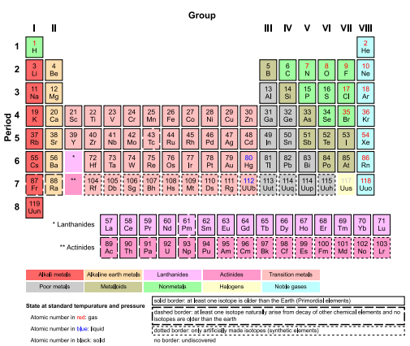
Mendeleev’s Periodic Table
A completely new approach to a problem that previously hadn’t had a successful visual solution.
Notes:
Novel
informative efficient
absolute minimum of graphical treatment

Slide 8
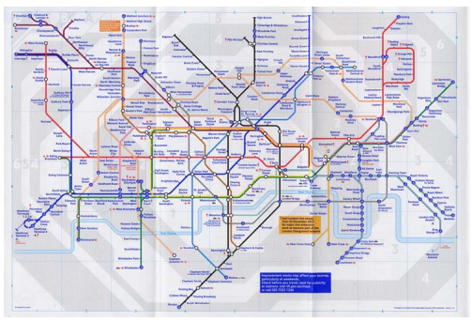
Harry Beck’s map of the London Underground (Tube map)
Highlighted the most relevant information and stripped away much of the irrelevant information
Notes:
Beck’s background was in drafting electrical circuits: he was used to drawing circuit layout lines at 45° and 90° angles, and he brought those conventions to the Tube map.
. Other maps that accurately show the geography can help you figure out what to do on the surface, but while you’re underground the only surface features that are accessible are the subway stations.

Slide 9
Standard formats and conventions
Bar graphs
Discrete data
Line graphs
Continuous/
Discrete data
Notes:
for bar graphs for discrete data, pie graphs for when you are more interested in a pretty picture than conveying knowledge.

Slide 10
Standard formats and conventions
Pretty picture but waste of space
Notes:
for bar graphs for discrete data, pie graphs for when you are more interested in a pretty picture than conveying knowledge.

Slide 11
Common Questions
What question you’re trying to answer, or what story you’re trying to tell?
How is the visualization going to be used?
Is it to reveal what is already known?
Is it to facilitate discovery?
Notes:
be specific about the tasks the users need to achieve or the knowledge they need to take away from the visualization. The readers’ specific knowledge needs may not be well understood initially, but this is still a critical factor to bear in mind during the design process.

Slide 12
A bit of Advice
Make it efficient!
Visually emphasize what matters (not for sensitive data) Use axes to convey meaning and give free information
Use conventions thoughtfully
Leverage the Aesthetics
Notes:
every bit of visual content will make it take longer to find any particular element in the visualization. The less data and visual noise there is on the page, the easier it will be for readers to find what they’re looking for. If your clearly stated goal can’t justify the existence of some of your content, try to live without it.
It can be made bigger, bolder, brighter, or more detailed, or called out with circles, arrows, or labels.
Note that this strategy of emphasizing relevance typically applies to presentation data, not research data: by changing the emphasis, the designer is intentionally changing the message.
the value implied by the axis, with no extra labeling required. For example, the periodic table is made up of clearly defined rows (periods) and columns (groups). A lot of information can be learned about an element by looking at what period and group it occupies The examples we’ve examined have used default, conventional representations for element symbols, subway line colors, and compass directions. Most of these seem too obvious to mention or notice, and that’s the point. They are easily understood and convey accurate information that is integrated extremely rapidly, while requiring almost no cognitive effort from the user and almost no creative effort from the designer. Ideally, this is how defaults and conventions should work.
A familiar look and feel can make it easier or more comfortable for readers to accept the information being presented At times, designers may want to make choices that could interfere with the usability of some or all of the visualization. This might be to emphasize one particular message at the cost of others, to make an artistic statement, to make the visualization fit into a limited space, or simply to make the visualization more pleasing or interesting to look at.

Slide 13
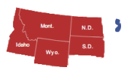
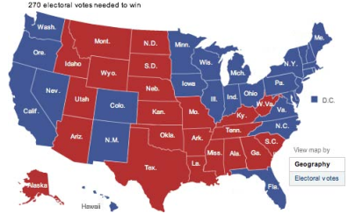
Trade-offs
2008 presidential election results
Notes:
, this is actually a situation in which an accurate depiction of the geography is irrelevant at best and terribly misleading at worst.

Slide 14
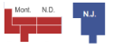
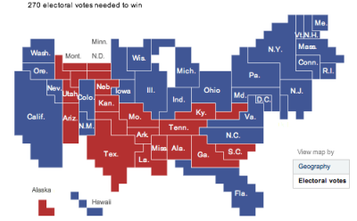
Trade-offs
2008 presidential election results

Slide 15
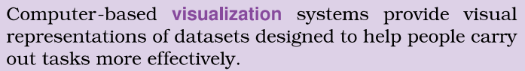
Computer Based Info-Vis
Augment human capabilities – but does not replace human
How to create?
How to interact?
NOT a precise science!
Trade-offs: computers, users, displays
Data Aspects & Vis Aspects
Notes:
Info vis actually increase human capabilities.
Computer based brings interaction
One vis does not fill all demands in all areas
Major aspects: Data Collection & Analysis, Visualization Creation & Validation

Slide 16
Are you feeling Lost?
Vis allows people to analyze data when they don’t know
exactly what questions they need to ask in advance.
Computational Techniques:
Statistics
Machine Learning
Specific Algorithms
Heuristics & Exhaustive Search
Notes:
If a fully automatic solution has been deemed to be acceptable, then there is no need for human judgement, and thus no need for you to design a Vis tool.
For example, consider the domain of stock market trading. Currently, there are many deployed systems for highfrequency trading that make decisions about buying and selling stocks When certain market conditions hold, When a specific price is reached, for example, With no need at all for a time – consuming check from a human in the loop. You would not want to design a Vis tool to help a person make that check faster, because even an augmented human Will not be able to reason about millions of stocks every second.
If there are many questions to ask from dozens to hundreds, then you would probably make an analysis process with a human in a loop.
Utilize the Powerful pattern detection properties that a human visual system has.
It can also be a first step before you do perform computational models!

Slide 17
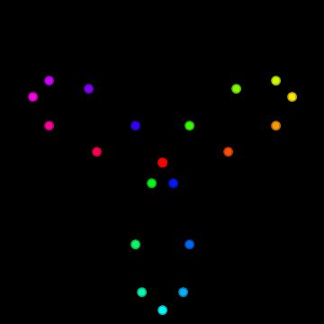
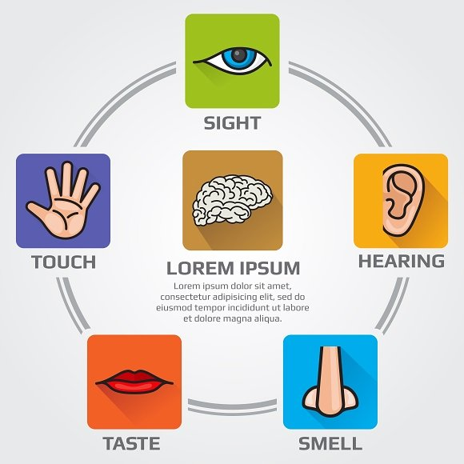
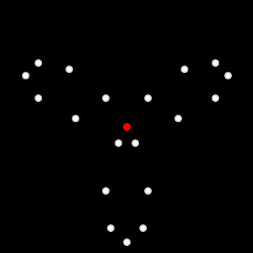
Challenges?
Sometimes a visualization may be misinterpreted – is the red dot moving on a line?
Notes:
Vis helps us to ask questions
When red and blue comes close
Is the boundary a circle?
Is the red dot moving on a line!

Slide 18
What a Vis Tool Can Do?
Help understand the user’s task
Help algorithm developers to choose the parameters
Help exploration and discovery
Help whether a system is working correctly
In telling a story
https://www.nytimes.com/interactive/2016/08/15/sports/olympics/usain-bolt-mens-100-meters-final.html
https://www.nytimes.com/interactive/2016/12/09/science/mapping-three-decades-of-global-water-change.html

Slide 19
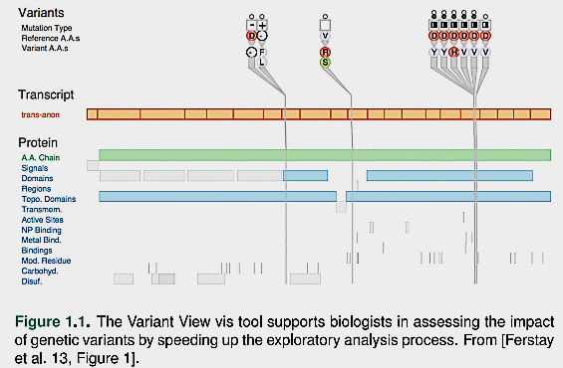
What a Vis Tool Can Do?
Notes:
Scientific discovery: This tool is designed to help biologists studying the genetic basis of disease through analyzing DNA sequence variation. Although these scien- tists make heavy use of computation as part of their larger work- flow. there‘s no hope of completely automating the process of can- cer research any time soon.

Slide 20
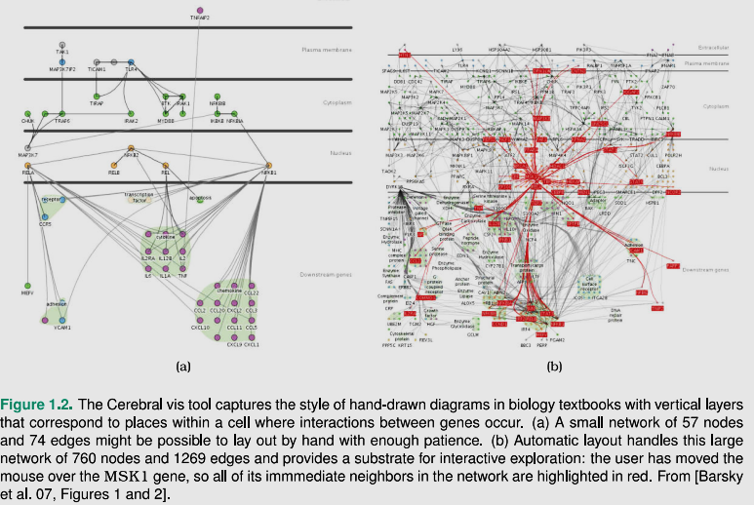
What a Vis Tool Can Do?
Notes:
Automation save human efforts!
Vertical layer indicate the location of the cells where interaction occurs
can deal with large datasets

Slide 21
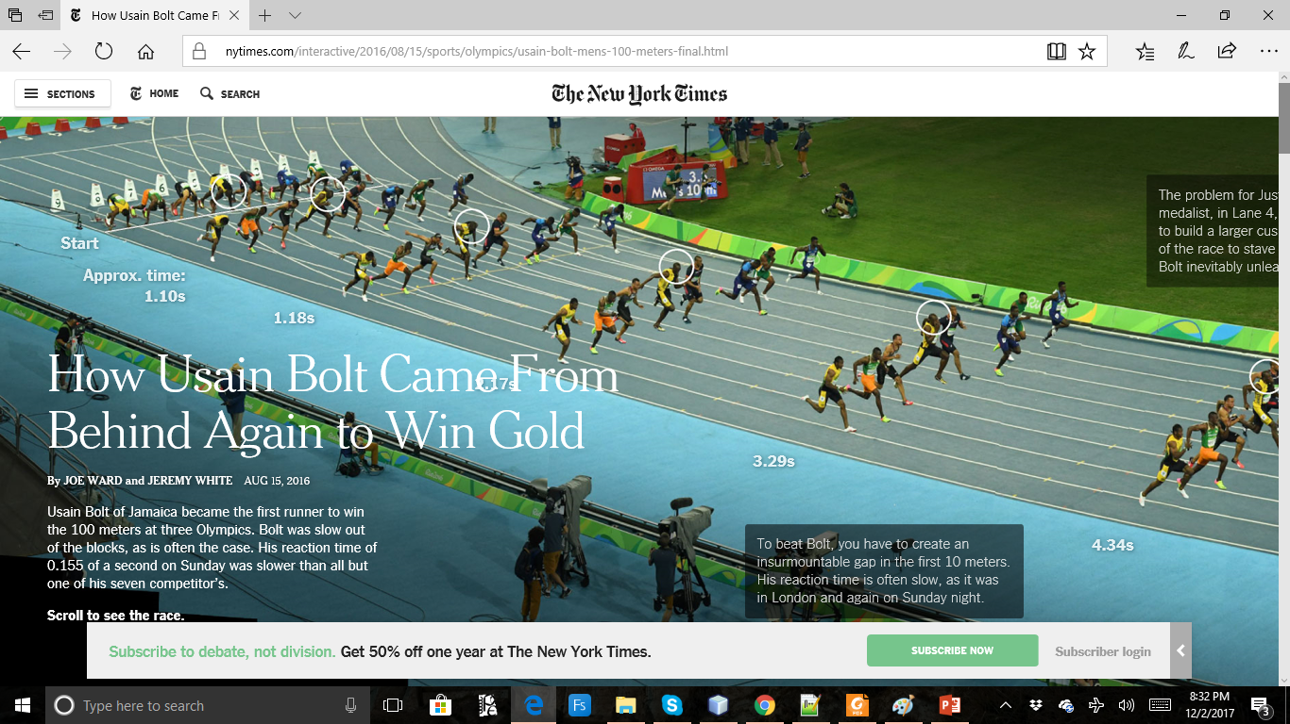

Slide 22
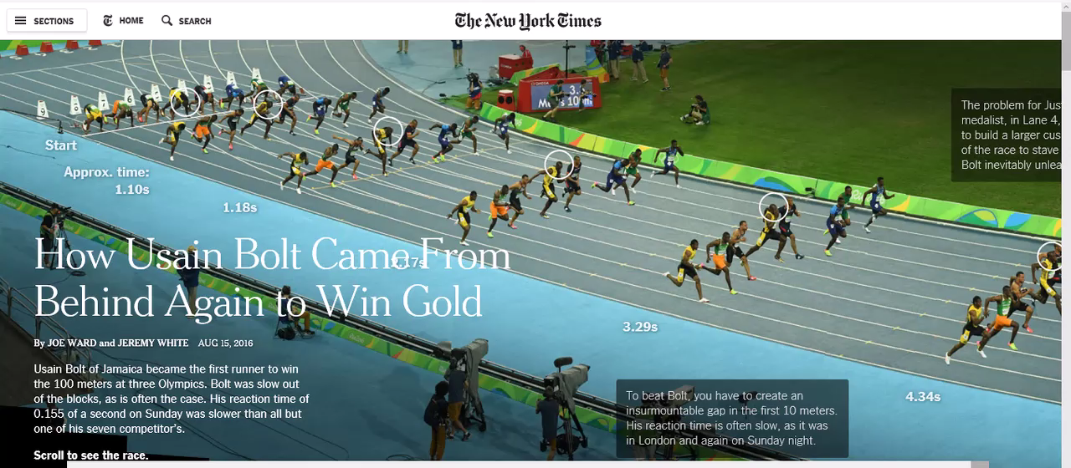

Slide 23
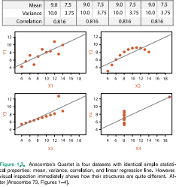
Summary or Details?
Statistics may lose information (e.g., about patterns)!
Notes:
Scatterplot
1- not interesting
2 – non linear
3 linear, outlier
4 varies vertically with one outlier

Slide 24
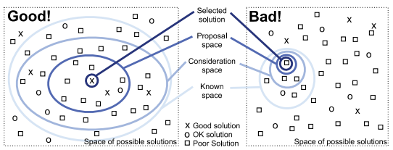
How to Design a Vis?
We will see design guidelines, but there is no absolute truth!
Notes:
How a good and bad designer reach to a good or bad solution
This course will enlarge your solution space

Slide 25
How to Design a Vis?
We will see design guidelines, but there is no absolute truth!
Notes:
How a good and bad designer reach to a good or bad solution
This course will enlarge your solution space

Slide 26
How do you know if it works?
Validation is hard
“Users perceive/use a visualization effectively” - what is user efficiency?
What is benchmark data?
How to measure quality of a vis tool?
Is there a trade-off among algorithms, display, memory usage …
Scalable? Can it deal with big data?

Slide 27
Learning Goal
Understand the difference between traditional and computer-aided visualization
Learn the basic properties of a good visualization
Able to distinguish between visualization and statistical computations
Describe the challenges and trade-offs in creating a good visualization
Get familiar with conventional visualizations.

